Slide 1
Oracle 11g: An Overview

Slide 2
Learning Objectives
Introduce the Oracle client/server database environment
Overview of Oracle SQL*Plus interface
and alternatives

Slide 3
Database System Architectures
Mainframe databases
Both DBMS and applications run on a mainframe computer
Users access database and applications using dumb terminals (remember COBOL?)

Slide 4
Database System Architectures
Personal databases
Both DBMS and applications run on user’s workstation
Used primarily for single-user applications
Can support small multi-user applications by storing the database and application files on a file server then transmitting the whole DB file to various users across a network
Notes:
MS Access, Paradox, dBASE, FoxPro, etc.
CAUTION: VERY DIFFICULT TO HAVE MULTIPLE USERS UPDATING AT THE SAME TIME!

Slide 5
Database System Architectures
Client/Server databases
Takes advantage of distributed processing and networked computers by distributing processing across multiple computers
  DBMS runs on central server
  Applications run on user’s (client) workstation
  Simultaneous multi-user access to the data across the network
Preferred for database applications that retrieve and manipulate small amounts of data from databases containing large numbers of records because they minimize network traffic and improve response times

Slide 6
Client/Server Database
Architecture
Many locations (tiers) where stuff can happen
Client Workstation Presentation
Workgroup Server Process Services
Enterprise Server Data Services
Two-tier Three-tier
Thick client Thin client

Slide 7
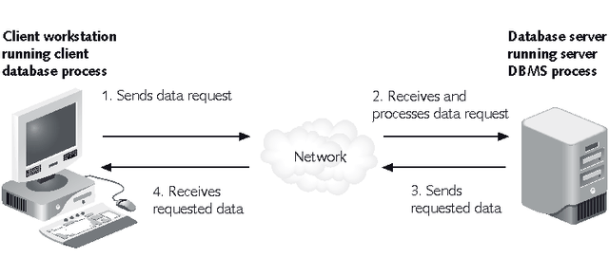
Client/Server Database Architecture

Slide 8
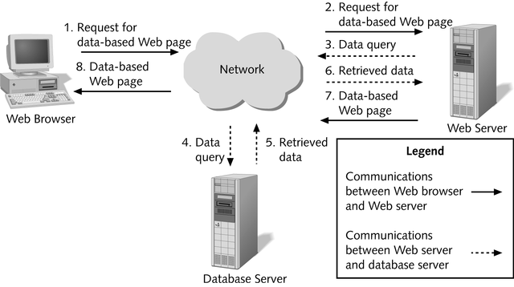
Web-based Client/Server

Slide 9
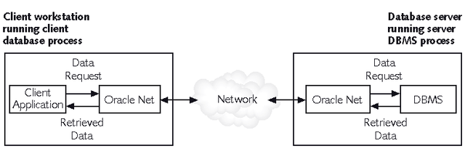
Oracle 9i/10g/11g Environment
Oracle11g is the latest release of Oracle Corporation’s relational database
All Oracle server- and client-side programs use Oracle Net, a utility that enables the network communication between the client and the server

Slide 10
Oracle Environment
(Server Side)
Enterprise Edition (on central DB server)
Or
Oracle Personal Edition
  Personal database that acts just like a client/server database to a single user
Notes:
Stores data
Handles security and user access
Manages transactions

Slide 11
Oracle Environment
(Client Side)
SQL*Plus
  interface for creating and testing command-line SQL queries and executing PL/SQL programs
SQL Developer
  GUI interface for building and manipulating a database

Slide 12
Oracle Environment
(Client Side)
Oracle Developer Suite
  for developing database applications
  Forms Builder
    for creating custom user applications
  Reports Builder
    for creating reports for displaying, printing, and distributing summary data
  Enterprise Manager
    for performing database administration tasks

Slide 13
Terminology
SQL = Structured Query Language
is the standard for RDBMS
DML
DDL
DCL
Notes:
Data Manipulation Language (DML) – Users via apps
Maintain and query database content
INSERT, UPDATE, DELETE, SELECT
Must COMMIT (save) or ROLLBACK (discard)
Data Definition Language (DDL) – Programmers & DBA’s
Build / modify database object structures
CREATE, ALTER, DROP tables, indexes, views, etc.
Data Control Language (DCL) – DBA’s
Protection of structure and/or content
GRANT, REVOKE privs
Note: DDL and DCL are executed immediately (no COMMIT/ROLLBACK)

Slide 14
SQL Timeline
1970 – Dr. Codd’s classic paper
1974-79 – IBM’s System R project (Sequel)
1979 – Oracle (then Relational Technology)
1981,82 – IBM SQL/DS, DB2
mid-1980’s – versions from nearly every HW/OS vendor plus new SW vendors
  DEC Rdb/VMS, Sybase, INGRES, DG/SQL,
SQL Standards (ANSI)
1986 | 1989 | 1992 | 1998 | 2003
 | “SQL-1” | “SQL-2” | “SQL-3” | “SQL-4”
Notes:
SQL-2: Oracle 7, SQLServer 6
SQL-3: Oracle 8, SQLServer 2000
SQL-4: Oracle 10, SQLServer 2005

Slide 15
User Accounts
An Oracle database consists of multiple user accounts
Each user account owns database objects
  Tables, Views, Stored programs, etc.
Each user has a user schema
  Area in the database where the user’s database objects are stored
  Identified by a unique username and protected by a password
Each user is granted specific privileges
  What they can do,
  own schema vs other schemas

Slide 16
SQL*Plus
Oracle SQL command line utility
Provides environment, editor, format, execution, interaction, and file commands
Accepts ad hoc entry of statements at the command line prompt (SQL>)
Accepts SQL statements from script files
Provides a line editor for modifying queries
Formats query results and displays on screen
Controls environmental settings
Accesses local and remote databases

Slide 17
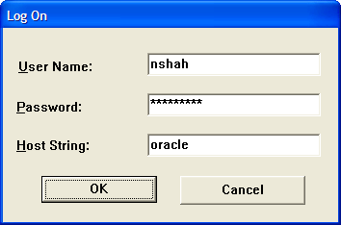
SQL*Plus
Click Start | Programs | Oracle 10g – OraClient10g – home1 | Application Development | SQL Plus
Enter your Username, Password, and Host String as provided by your Database Administrator
Notes:
User: STUnn
Password: STUnn
Host: csomo

Slide 18
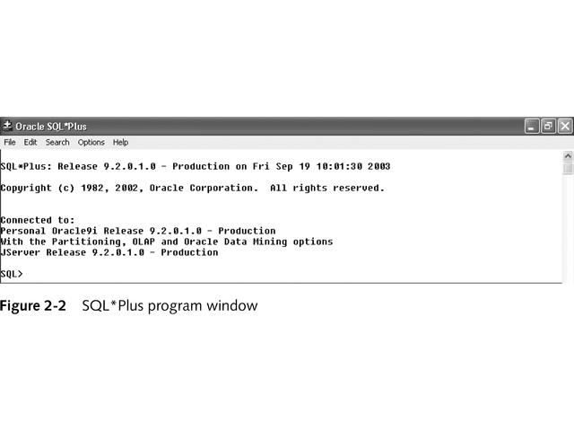
SQL*Plus
To exit
  Type exit at SQL> prompt
  Use File – Exit from menu
  Click Close button on SQL*Plus window

Slide 19
SQL*Plus Help
SQL> HELP INDEX Enter Help [topic] for help. @ COPY PAUSE SHUTDOWN @@ DEFINE PRINT SPOOL / DEL PROMPT SQLPLUS ACCEPT DESCRIBE QUIT START APPEND DISCONNECT RECOVER STARTUP ARCHIVE LOG EDIT REMARK STORE ATTRIBUTE EXECUTE REPFOOTER TIMING BREAK EXIT REPHEADER TTITLE BTITLE GET RESERVED WORDS (SQL) UNDEFINE CHANGE HELP RESERVED WORDS (PL/SQL) VARIABLE CLEAR HOST RUN WHENEVER OSERROR COLUMN INPUT SAVE WHENEVER SQLERROR COMPUTE LIST SET CONNECT PASSWORD SHOW SQL> HELP DESCRIBE DESCRIBE -------- Lists the column definitions for a table, view, or synonym, or the specifications for a function or procedure. DESC[RIBE] {[schema.]object[@connect_identifier]} SQL>

Slide 20
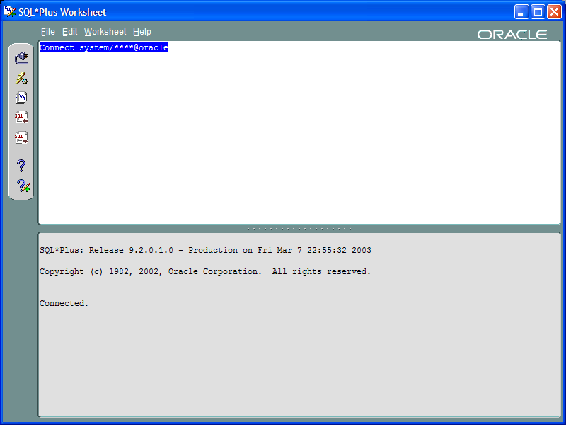
SQL*Plus Worksheet
Part of Enterprise Manager that can be launched standalone.

Slide 21
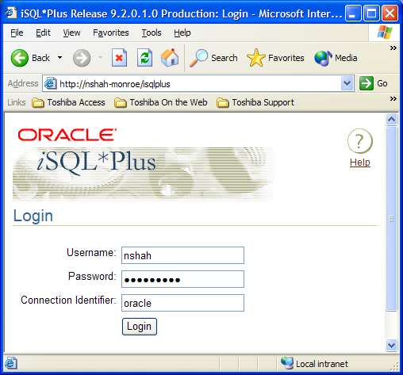
iSQLPlus Web interface
http://btacs.tru.ca:5560/isqlplus 10g
Notes:
Was port 7778 for 9i

Slide 22
Using SQL*Plus
All commands must be terminated with a semicolon ;
Very primitive editing
  Backspace only, no left/right arrows
  Can use copy / paste from text editor
  EDIT of last command
Character data
  Case sensitive
  Single quotes
  ‘M’ ‘Sarah’

Slide 23
Viewing Table Information
Viewing a table’s structure
  DESCRIBE table_name;
SQL> describe shah.student;
Name Null? Type
-------------------------- -------- -------------
STUDENTID NOT NULL CHAR(5)
LAST NOT NULL VARCHAR2(15)
FIRST NOT NULL VARCHAR2(15)
STREET VARCHAR2(25)
CITY VARCHAR2(15)
STATE CHAR(2)
ZIP CHAR(5)
STARTTERM CHAR(4)
BIRTHDATE DATE
FACULTYID NUMBER(3)
MAJORID NUMBER(3)
PHONE CHAR(10)

Slide 24
Oracle Data Dictionary
Contains tables that describe the database structure
  Is in the SYSTEM user schema
Is automatically updated as users create and modify tables
  Cannot be updated directly
Contains views that allow users to retrieve information about the database structure

Slide 25
Data Dictionary Views
Views present data in different formats depending on the privileges of the user
USER
ALL
DBA
Notes:
USER
shows all objects belonging to the current user
ALL
shows all objects belonging to the current user, plus any the user has privileges to manipulate
DBA
allows users with DBA privileges to view objects of all database users

Slide 26
Data Dictionary Views
SELECT field1, field2, …
FROM privilege_viewname;
SQL> select table_name from user_tables;
TABLE_NAME
------------------
COURSE
CRSSECTION
CUSTOMER
DEPARTMENT
...
WORKER
21 rows selected.
SQL> select table_name from all_tables;
TABLE_NAME
--------------------
DUAL
...
COURSE
CRSSECTION
...
64 rows selected.
SQL> select table_name from dba_tables;
select table_name from dba_tables
*
ERROR at line 1:
ORA-00942: table or view does not exist
Notes:
As seen from the SHAH user schema
all_tables anything that has granted SELECT to PUBLIC
Cannot see dba_ views as not a dba account

Slide 27
Oracle Data Dictionary Views
OBJECTS | All database objects
TABLES | Database tables
INDEXES | Table indexes created to improve query performance
VIEWS | Database views
SEQUENCES | Sequences created to automatically generate surrogate key values
USERS | Database users
CONSTRAINTS | Table constraints
CONS_CONSTRAINTS | Table columns that have constraints
IND_COLUMNS | Indexed columns
TAB_COLUMNS | All table columns

Slide 28
SQL Scripts
Script: text file that contains a sequence of SQL commands
Running a script:
  SQL> START path_to_script_file;
  Path cannot contain any blank spaces
  Can use @ in place of START command
Notes:
@j:\bbarlow\comp256\resources\Indo-US_College.sql

